Slide 1
News Frequency - Amazon
Group 3
Leyi Hua (lh3064@nyu.Edu)
Leo Lin(zl2807@nyu.Edu)
Zhiheng Wang(zw2855@nyu.Edu)

Slide 2
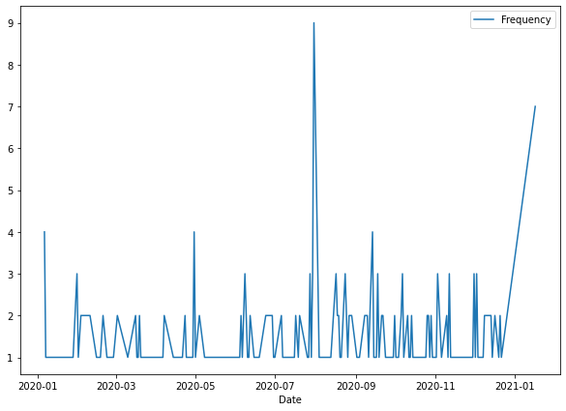


Compute $λ$ for a reasonable time sample
process
Result
Goal:
News source: Google news
Company: AMZN (Amazon)
Solution:
Use GoogleNews api to pull search results from google news
1. Search AMZN news from time range Jan 01, 2020 to Jan 17, 2021 (382 days)
2. Count the unique values of date for frequency, then
Visualization: plot
Compute $λ$: calculate the average of each day’s amount of news articles
Compute 𝛌: calculate the average of each day’s amount of news articles
Implementation:
$$λ=1.542169$$
(Dhingra, 2020)
Code: https://github.com/Emma3434/News-Frequency

Slide 3
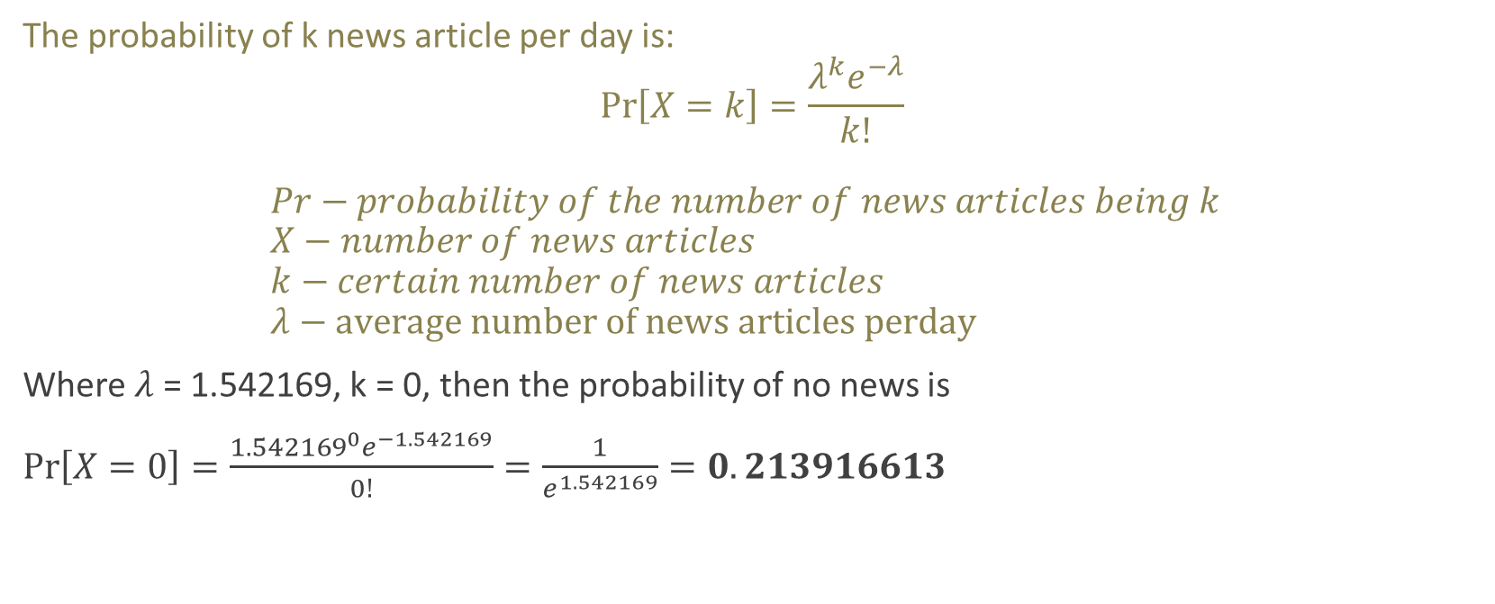
What is the probability of no news on the stock?
The probability of k news article per day is: $\operatorname{Pr}\left[X=k\right]=\frac{λ^{k}e^{−λ}}{k!}$ $Pr−probability of the number of news articles being k$ $X−number of news articles$ $k−certain number of news articles$ $λ−average number of news articles perday$
Where $λ$ = 1.542169, k = 0, then the probability of no news is
$\operatorname{Pr}\left[X=0\right]=\frac{{1.542169}^{0}e^{−1.542169}}{0!}=\frac{1}{e^{1.542169}}=0.213916613$

Slide 4

What is the probability of 3𝜆 news articles on the stock?
The probability of k news article per day is: $\operatorname{Pr}\left[X=k\right]=\frac{λ^{k}e^{−λ}}{k!}$ $Pr−probability of the number of news articles being k$ $X−number of news articles$ $k−certain number of news articles$ $λ−average number of news articles perday$
Where $λ$ = 1.542169, k = 3𝜆 , then the probability of no news is
$\operatorname{Pr}\left[X=3λ\right]=\frac{{1.542169}^{3∗1.542169}e^{−1.542169}}{(3∗1.542169)!}=0.066134358$

Slide 5
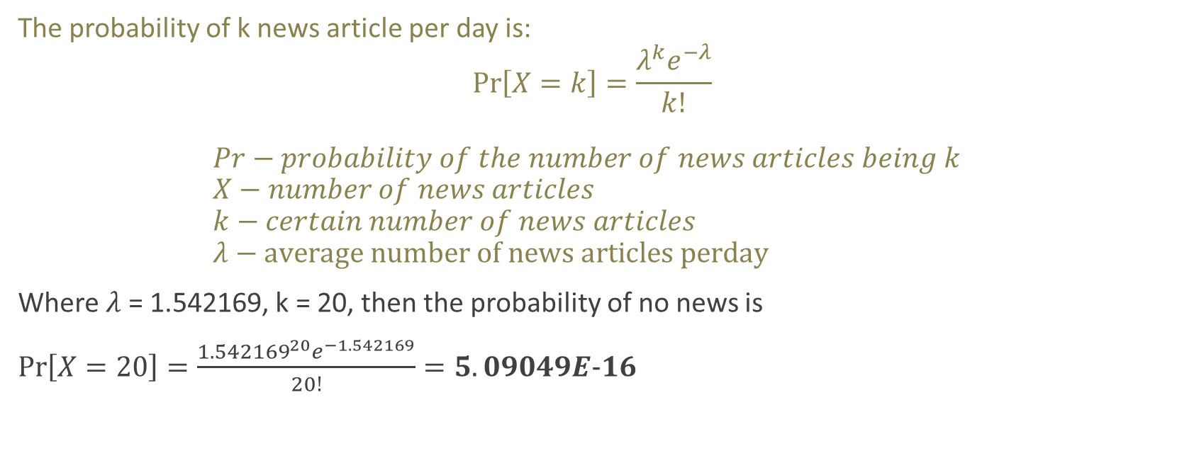
What is the probability of 20 news articles on the stock?
The probability of k news article per day is: $\operatorname{Pr}\left[X=k\right]=\frac{λ^{k}e^{−λ}}{k!}$ $Pr−probability of the number of news articles being k$ $X−number of news articles$ $k−certain number of news articles$ $λ−average number of news articles perday$
Where $λ$ = 1.542169, k = 20, then the probability of no news is
$\operatorname{Pr}\left[X=20\right]=\frac{{1.542169}^{20}e^{−1.542169}}{20!}=5.09049E−16$

Slide 6
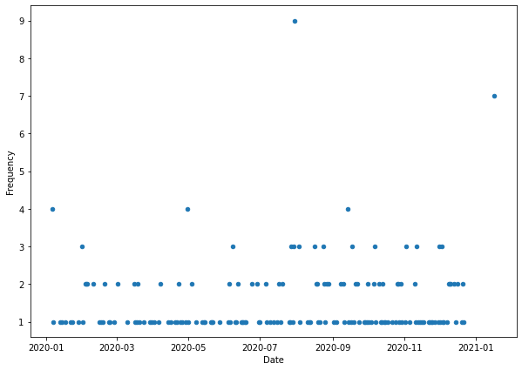
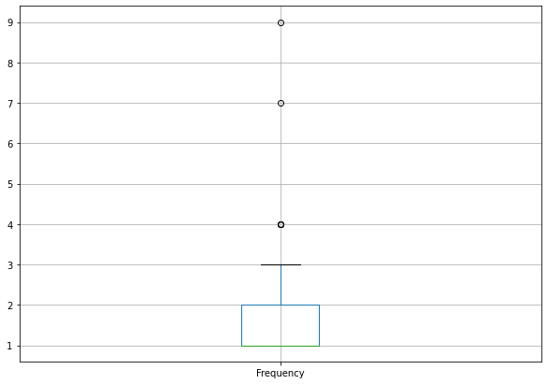
How would you define an “unusual amount of news” for your stock?
To find outliers in data, we must calculate Q1 and Q3 of the dataset. By doing that, we find the boundary of data and whoever lays outside of the boundary is abnormality, thus, an unusual amount of news for the stock.
Here is a box plot of the dataset. Q1 and Q3: (1.0, 2.0)
Abnormal

Slide 7
Reference
Dhingra, M. (2020, June 17). GoogleNews API—Live News from Google News using Python. Medium. https://medium.com/analytics-vidhya/googlenews-api-live-news-from-google-news-using-python-b50272f0a8f0

